Slide 1
Chapter 5 – System Modeling
Lecture 1

Slide 2
Topics covered
Context models
Interaction models

Slide 3
System modeling
System modeling is the process of developing abstract models of a system, with each model presenting a different view or perspective of that system.
System modeling has now come to mean representing a system using some kind of graphical notation, which is now almost always based on notations in the Unified Modeling Language (UML).
System modelling helps the analyst to understand the functionality of the system and models are used to communicate with customers.

Slide 4
Purposes of system Modeling
Testing a physical entity before building it.
Communication with customers.
Visualization.
Reduction of complexity.

Slide 5
Existing and planned system models
Models of the existing system are used during requirements engineering. They help clarify what the existing system does and can be used as a basis for discussing its strengths and weaknesses. These then lead to requirements for the new system.
Models of the new system are used during requirements engineering to help explain the proposed requirements to other system stakeholders. Engineers use these models to discuss design proposals and to document the system for implementation.
In a model-driven engineering process, it is possible to generate a complete or partial system implementation from the system model.

Slide 6
System perspectives
An external perspective, where you model the context or environment of the system.
An interaction perspective, where you model the interactions between a system and its environment, or between the components of a system.
A structural perspective, where you model the organization of a system structure of data flow.
A behavioral perspective, where you model the dynamic behavior of the system and how it responds to events.

Slide 7
UML(Unified Modeling Language) diagram types
Use case diagrams, which show the interactions between a system and its environment.
Sequence diagrams, which show interactions between actors and the system and between system components.

Slide 8
Context models
Context models are used to illustrate the operational context of a system - they show what lies outside the system boundaries.
Social and organisational concerns may affect the decision on where to position system boundaries.
Architectural models show the system and its relationship with other systems.

Slide 9
System boundaries
System boundaries are established to define what is inside and what is outside the system.
They show other systems that are used or depend on the system being developed.
The position of the system boundary has a profound effect on the system requirements.
Defining a system boundary is a political judgment
There may be pressures to develop system boundaries that increase / decrease the influence or workload of different parts of an organization.

Slide 10
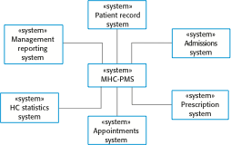
The context of the MHC-PMS

Slide 11
Process perspective
Context models simply show the other systems in the environment, not how the system being developed is used in that environment.
Process models reveal how the system being developed is used in broader business processes.
UML activity diagrams may be used to define business process models.

Slide 12
How to draw Activity Diagram?
Before drawing an activity diagram we should identify the following elements:
Initial State or Start Point
Activity or Action State
Object Flow
Decisions and Branching
Synchronization
Time Event
Final State or End Point

Slide 13
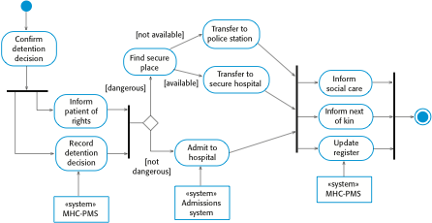
Process model of involuntary detention

Slide 14
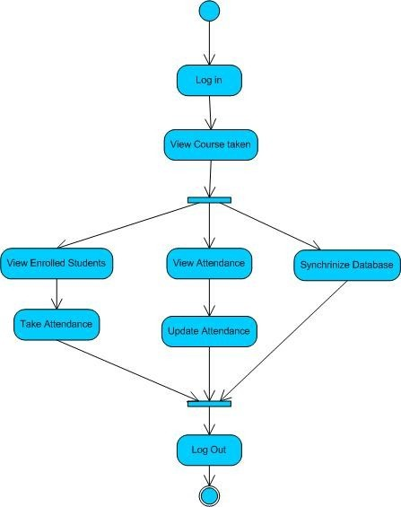
Activity Diagram of Attendance Management System

Slide 15
Interaction models
Modeling user interaction is important as it helps to identify user requirements.
Modeling system-to-system interaction highlights the communication problems that may arise.
Modeling component interaction helps us understand if a proposed system structure is likely to deliver the required system performance and dependability.
Use case diagrams and sequence diagrams may be used for interaction modelling.

Slide 16
Use case modeling
Use cases were developed originally to support requirements elicitation and now incorporated into the UML.
Each use case represents a discrete task that involves external interaction with a system.
Actors in a use case may be people or other systems.
Represented diagrammatically to provide an overview of the use case and in a more detailed textual form.

Slide 17

Transfer-data use case
A use case in the MHC-PMS

Slide 18
Tabular description of the ‘Transfer data’ use-case
MHC-PMS: Transfer data
Actors | Medical receptionist, patient records system (PRS)
Description | A receptionist may transfer data from the MHC-PMS to a general patient record database that is maintained by a health authority. The information transferred may either be updated personal information (address, phone number, etc.) or a summary of the patient’s diagnosis and treatment.
Data | Patient’s personal information, treatment summary
Stimulus | User command issued by medical receptionist
Response | Confirmation that PRS has been updated
Comments | The receptionist must have appropriate security permissions to access the patient information and the PRS.

Slide 19
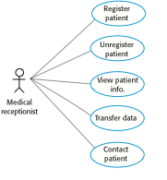
Use cases in the MHC-PMS involving the role ‘Medical Receptionist’

Slide 20
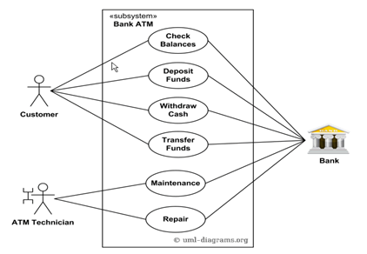
Design a Use-case diagram for Bank ATM system.

Slide 21
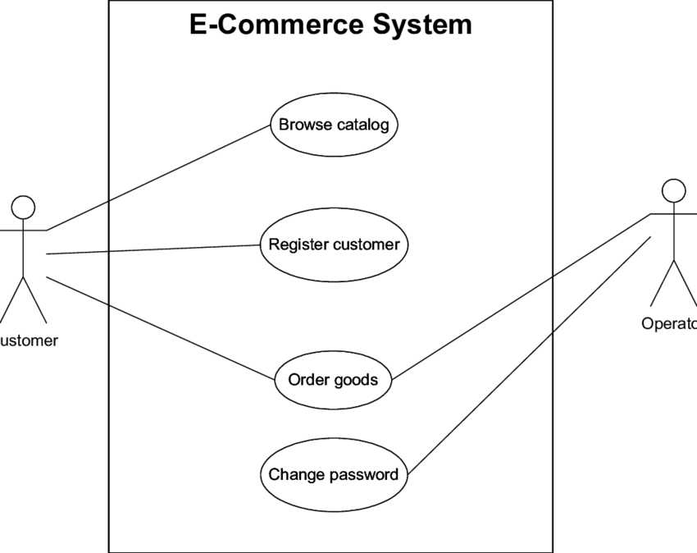

Slide 22
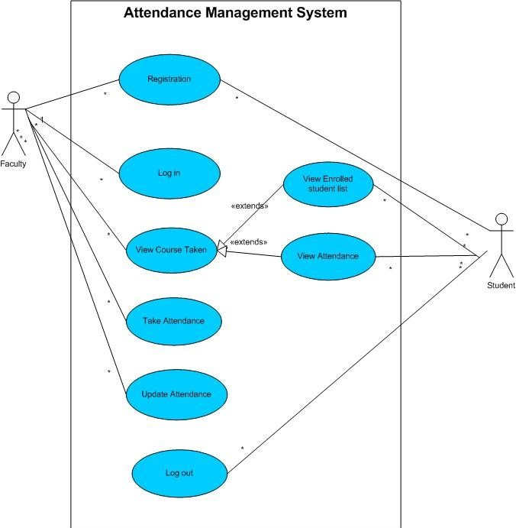
Attendance Management System

Slide 23
Sequence diagrams
Sequence diagrams are part of the UML and are used to model the interactions between the actors and the objects within a system.
A sequence diagram shows the sequence of interactions that take place during a particular use case or use case instance.
The objects and actors involved are listed along the top of the diagram, with a dotted line drawn vertically from these.
Interactions between objects are indicated by annotated arrows.

Slide 24
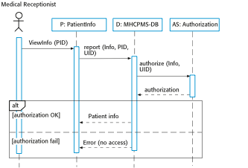
Sequence diagram for View patient information

Slide 25
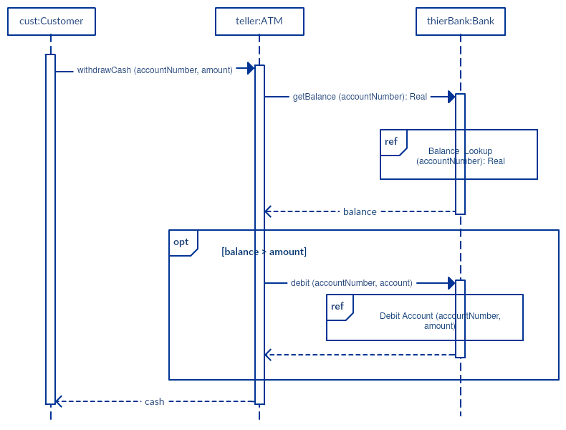

Slide 26
Design
Please Refer MS-Word Notes ( Book Pressman) for details sent along with these slides.

Slide 27
Design
Software design sits at the technical kernel of software engineering and is applied regardless of the software process model that is used.
Beginning once software requirements have been analyzed and modeled, software design is the last software engineering action within the modeling activity and sets the stage for construction (code generation and testing)

Slide 28
Analysis Model -> Design Model

Slide 29
Design outputs
The data/class design transforms class models into design class realizations and the requisite data structures required to implement the software. The objects and relationships defined in the CRC diagram and the detailed data content depicted by class attributes and other notation provide the basis for the data design action.
The architectural design defines the relationship between major structural elements of the software, the architectural styles and design patterns that can be used to achieve the requirements.
The interface design describes how the software communicates with systems that interoperate with it, and with humans who use it. An interface implies a flow of information (e.g., data and/or control) and a specific type of behavior.
The component-level design transforms structural elements of the software architecture into a procedural description of software components.

Slide 30
Design and Quality
the design must implement all of the explicit requirements.
the design must be a readable, understandable.
the design should provide a complete picture of the software.

Slide 31
Quality Guidelines
A design should exhibit an architecture that (1) has been created using recognizable architectural styles or patterns, (2) is composed of components that exhibit good design characteristics and (3) can be implemented in an evolutionary fashion.
A design should be modular.
A design should contain distinct representations of data, architecture, interfaces, and components.
A design should lead to data structures that are appropriate for the classes to be implemented and are drawn from recognizable data patterns.
Notes:
A design should be modular

Slide 32
Quality Guidelines continued
A design should lead to components that exhibit independent functional characteristics.
A design should lead to interfaces that reduce the complexity of connections between components and with the external environment.
A design should be represented using a notation that effectively communicates its meaning.

Slide 33
Quality Attributes
Functionality
Usability
Reliability
Performance
Supportability

Slide 34
Functionality is assessed by evaluating the feature set and capabilities of the program, the generality of the functions that are delivered, and the security of the overall system.
Usability is assessed by considering human factors , overall aesthetics, consistency, and documentation.
Reliability is evaluated by measuring the frequency and severity of failure, the accuracy of output results, the mean-time-to-failure (MTTF), the ability to recover from failure, and the predictability of the program.
Performance is measured by considering processing speed, response time, resource consumption, throughput, and efficiency.
Supportability combines the ability to extend the program (extensibility), adaptability, serviceability—these three attributes represent a more common term, maintainability—and in addition, testability, compatibility, configurability .the ease with which a system can be installed, and the ease with which problems can be localized.

Slide 35
Fundamental Concepts
Abstraction—data, procedure, control
Architecture—the overall structure of the software
Patterns—”conveys the essence” of a proven design solution
Separation of concerns—any complex problem can be more easily handled if it is subdivided into pieces

Slide 36
Fundamental Concepts
Modularity—compartmentalization of data and function
Hiding—controlled interfaces
Functional independence—single-minded function and low coupling
Refinement—elaboration of detail for all abstractions
Aspects—a mechanism for understanding how global requirements affect design
Refactoring—a reorganization technique that simplifies the design

